Slide 1
Safaricom Digital Academy Data Science GIS Assignments
submitted by
by
Barbara Akelo osiro

Slide 2
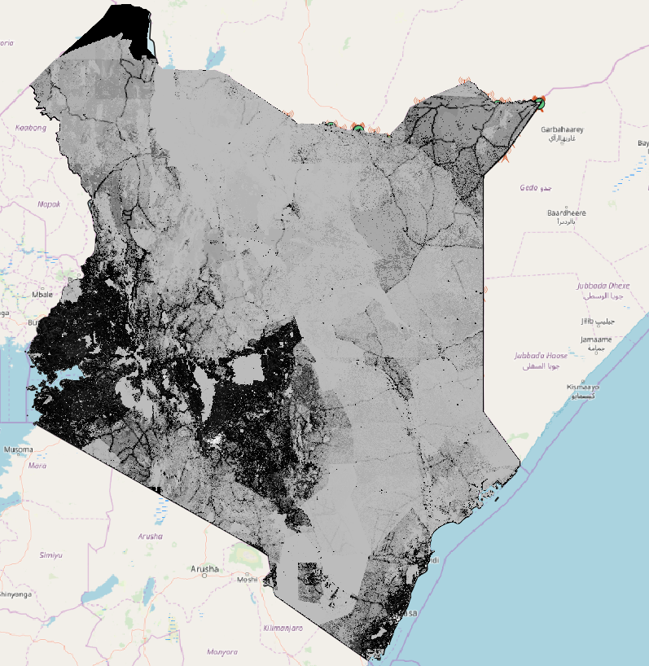
A screen shot of raster population layer

Slide 3
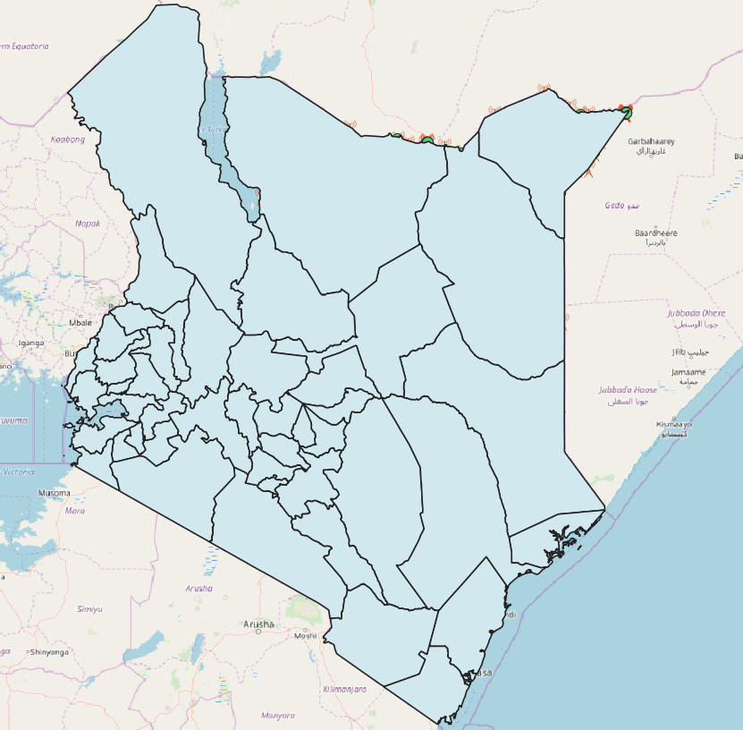
A screen shot of County Layer

Slide 4
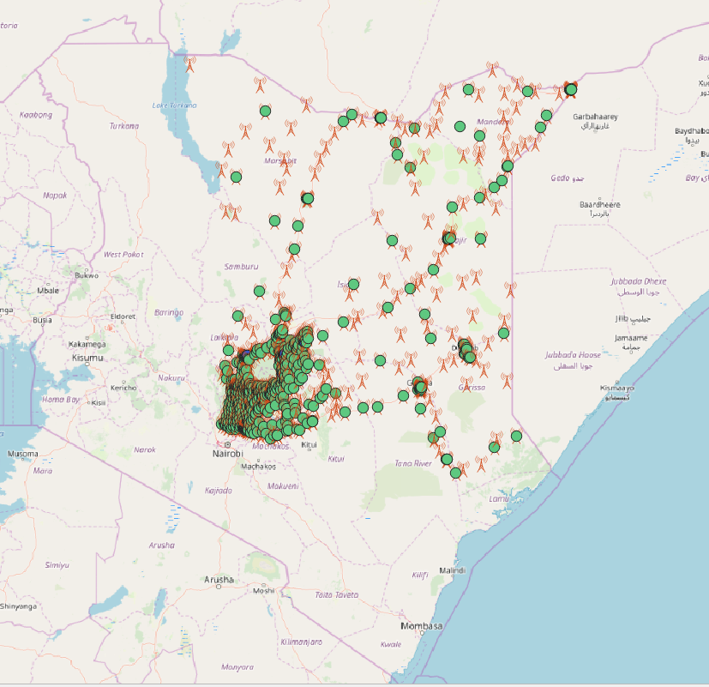
A screen shot of street map layer

Slide 5
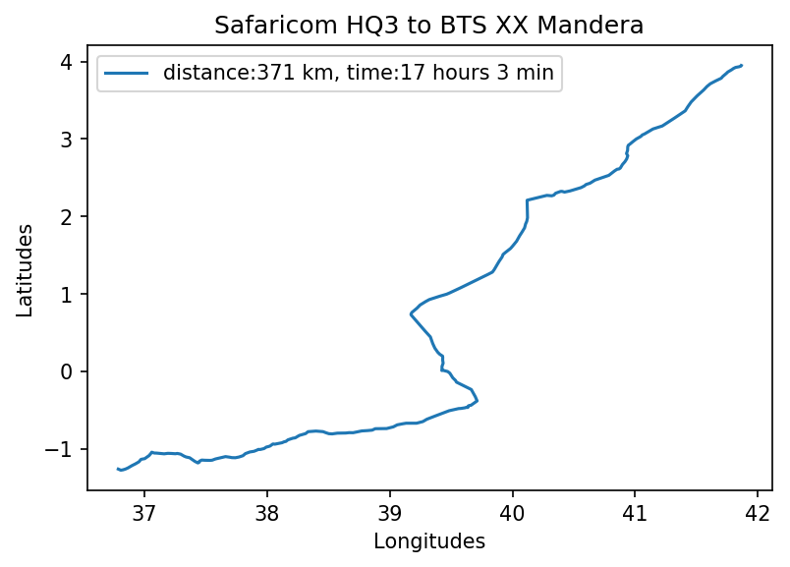
Saf HQ3 to Mandera one way trip pic 1

Slide 6
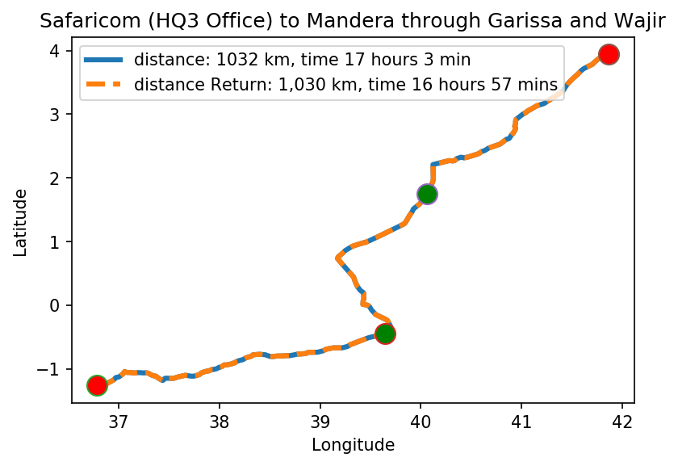
Saf HQ3 to Mandera return trip pic 2

Slide 7
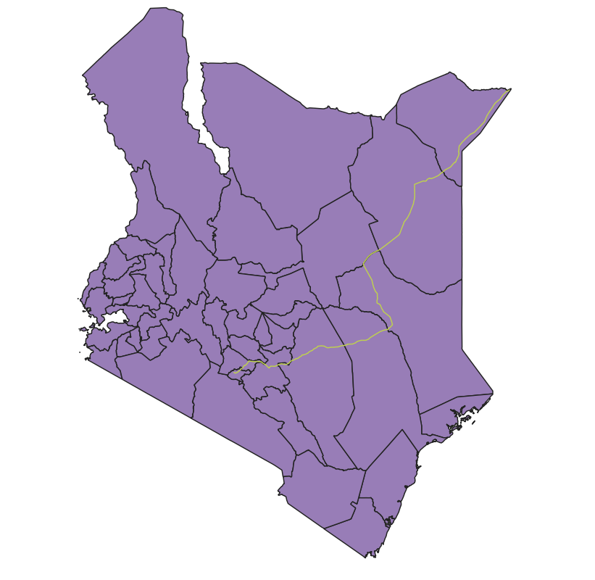
Saf HQ3 to Mandera return trip against the county layer

Slide 8
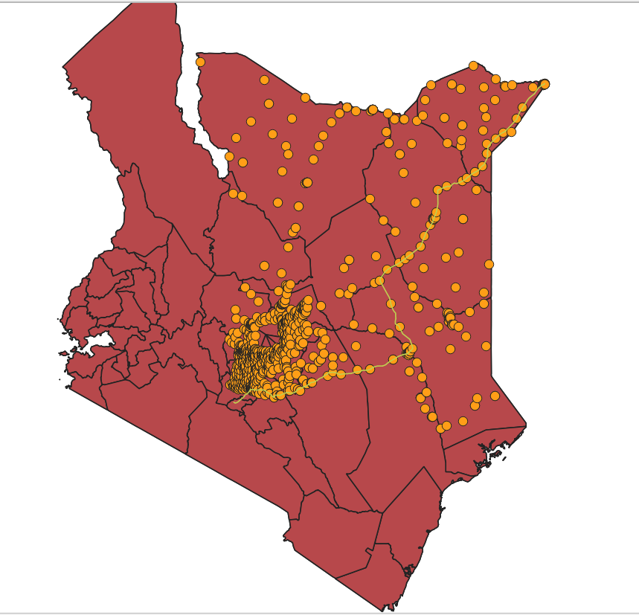
Saf HQ3 to Mandera return trip against the BTS layer

Slide 9
#Setting out the various per unit costs
'Total_hours | 34hrs 0min'
'Total_distance | 2062kms'
'Absolute Rules:15 min break after every 2 hours, driving is between 5am and 10pm | 17 hours per day 2 hours of rest
34 hours to cover in 15 hours per day | 2.26 days approximately 3 days
'Mileage allowance (Ksh.30 / km) by Total distance 'Total per diem rate of 8,000/ = per night for 3 days/2 nights | 2062kms= Ksh.61,860', Ksh.16,000',
'Accommodation of 7,000/ = per night for 3 days/2 nights = | Ksh.14,000',
'Total Fuel consumption Total distance = 2062kms*(0.1Litres/km)=206.2Litres (fuel is Ksh.98/ l) | Ksh.20207.60

Slide 10
#Setting out the various overall journey costs
'Mileage allowance as per AA rates for Kenya FY2018 (Ksh.30 / km)', | Ksh.30 / km
'Fuel consumption per km. Assume the company only uses long chase Land cruisers | 10Litres/100 km
'Accommodation of not more than 7,000/ = per night', | 7,000/ = per night
'Standard per diem rate of 8,000/ = per night') | 8,000/ = per night

